Slide 1


FC BARCELONA PERFORMANCE BEFORE vs AFTER LIONEL MESSI
Class Project Presentation – MOULIK JAIN

Slide 2

GUIDING QUESTION
How did FC Barcelona’s overall performance metrics (goals, wins, possession, and points) change before and after Lionel Messi’s departure in 2021?
Purpose: To evaluate whether Messi’s departure meaningfully impacted Barcelona’s match-level and season-level performance.

Slide 3

CHALLENGE ENCOUNTERED
One major challenge I faced was making the R Markdown project fully replicable.
Initially, the notebook used absolute file paths, which caused knitting errors when the project folder was zipped and moved.
I solved this by:
Reorganizing the project into a self-contained folder
Adding a dedicated data/ directory
Switching to relative paths using list.files()
Using knitr::opts_knit$set(root.dir = getwd()) to stabilize the working directory
This ensured that anyone, including the instructor, can knit the project successfully without changing anything.

Slide 4
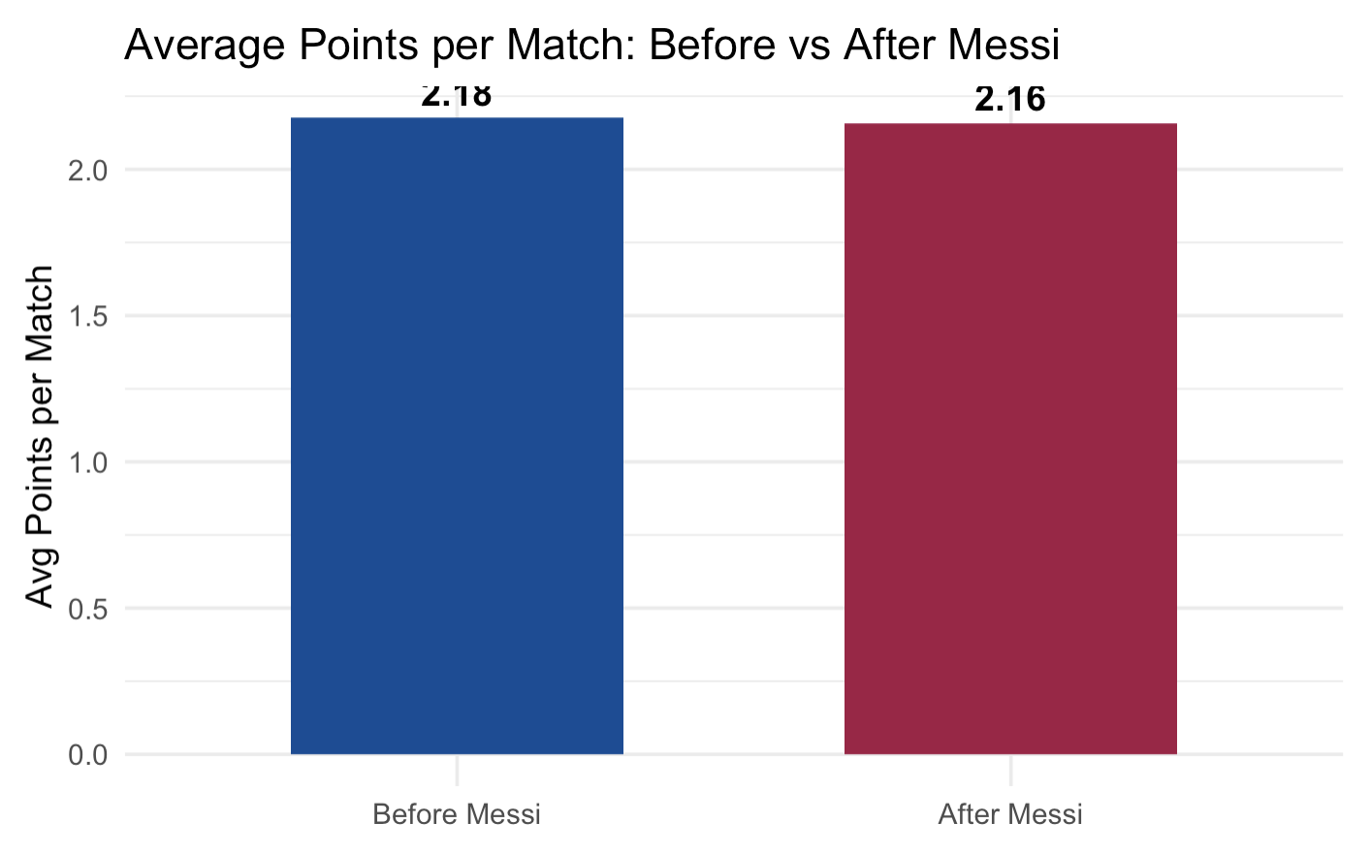
KEY VISUALIZATION
Barcelona averaged slightly fewer points per match after Messi left (2.18 → 2.16), marking a modest performance dip immediately following his departure.

Slide 5
CONCLUSION
KEY TAKEAWAY –
Barcelona’s performance dropped noticeably right after Messi left — especially in points per match and win rate.
However, the most recent seasons show gradual improvement, suggesting tactical adaptation, stronger team chemistry, and rebuilding progress under new management.

Slide 6

THANKS!!

